Slide 1


The Health Effects of Radiofrequency Radiation
Woodbridge, CT
Oct 22, 2020
Eric Swanson
professor of physics at the University of Pittsburgh
fellow of the American Physical Society
I will be presenting the consensus scientific view on RFR.

Slide 2
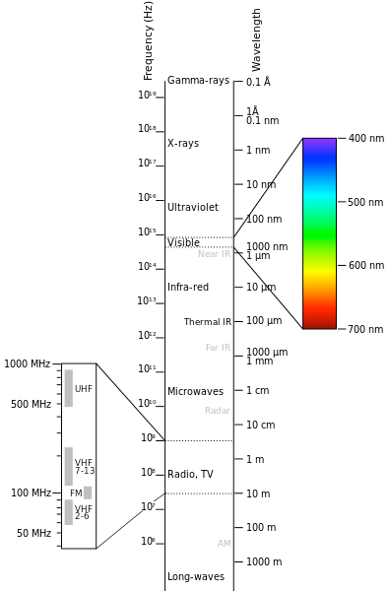
There is no verified evidence that non-ionizing EM radiation has any effect other than heating of tissue.

Slide 3
There is no verified evidence that non-ionizing EM radiation has any effect other than heating of tissue.
thermal
microwave
5G
4G
radio

Slide 4
There is no verified evidence that non-ionizing EM radiation has any effect other than heating of tissue.
800,000 GHz
thermal
microwave
5G
30 GHz
4G
2 GHz
radio

Slide 5

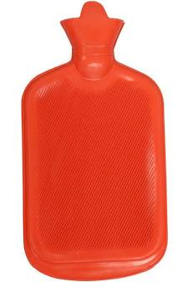
The FCC regulates RFR to limit thermal effects.
Limits are very strict, and are set at
1/50 the level of what is detectable in animal experiments.
For comparison, my heating pad produces about 50 times more heating than the FCC permits.

Slide 6
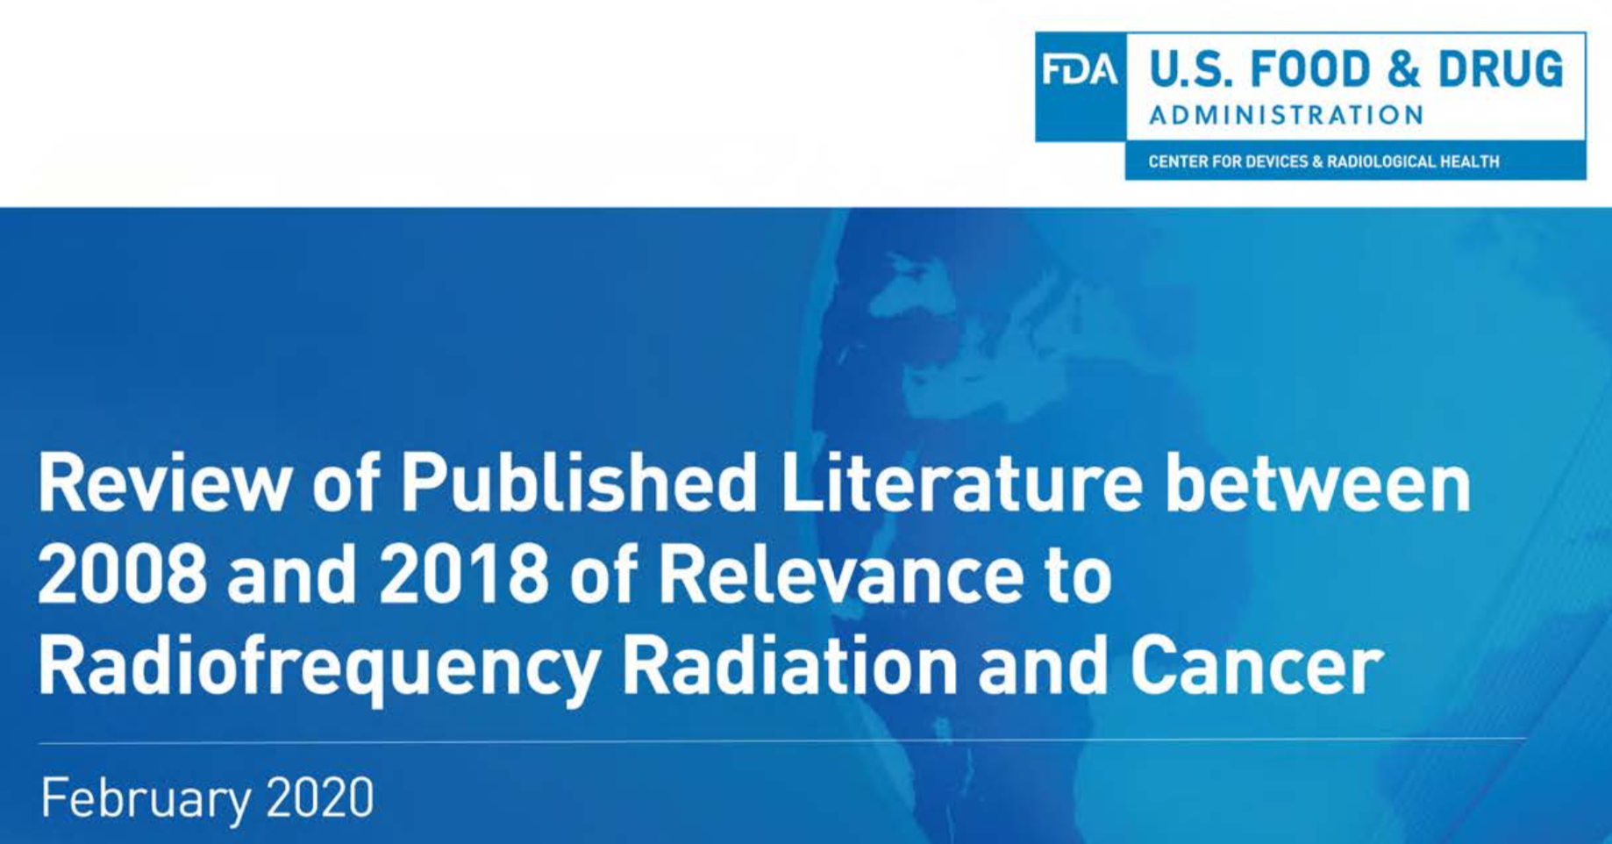
The FCC regularly updates its rules.
“[For 2008-2018] there have been approximately 125 articles that are most relevant for the study of any effects of RFR on animals. However, none have adequately demonstrated that localized exposure of RFR at levels that would be encountered by cell phone users can lead to adverse effects.”

Slide 7
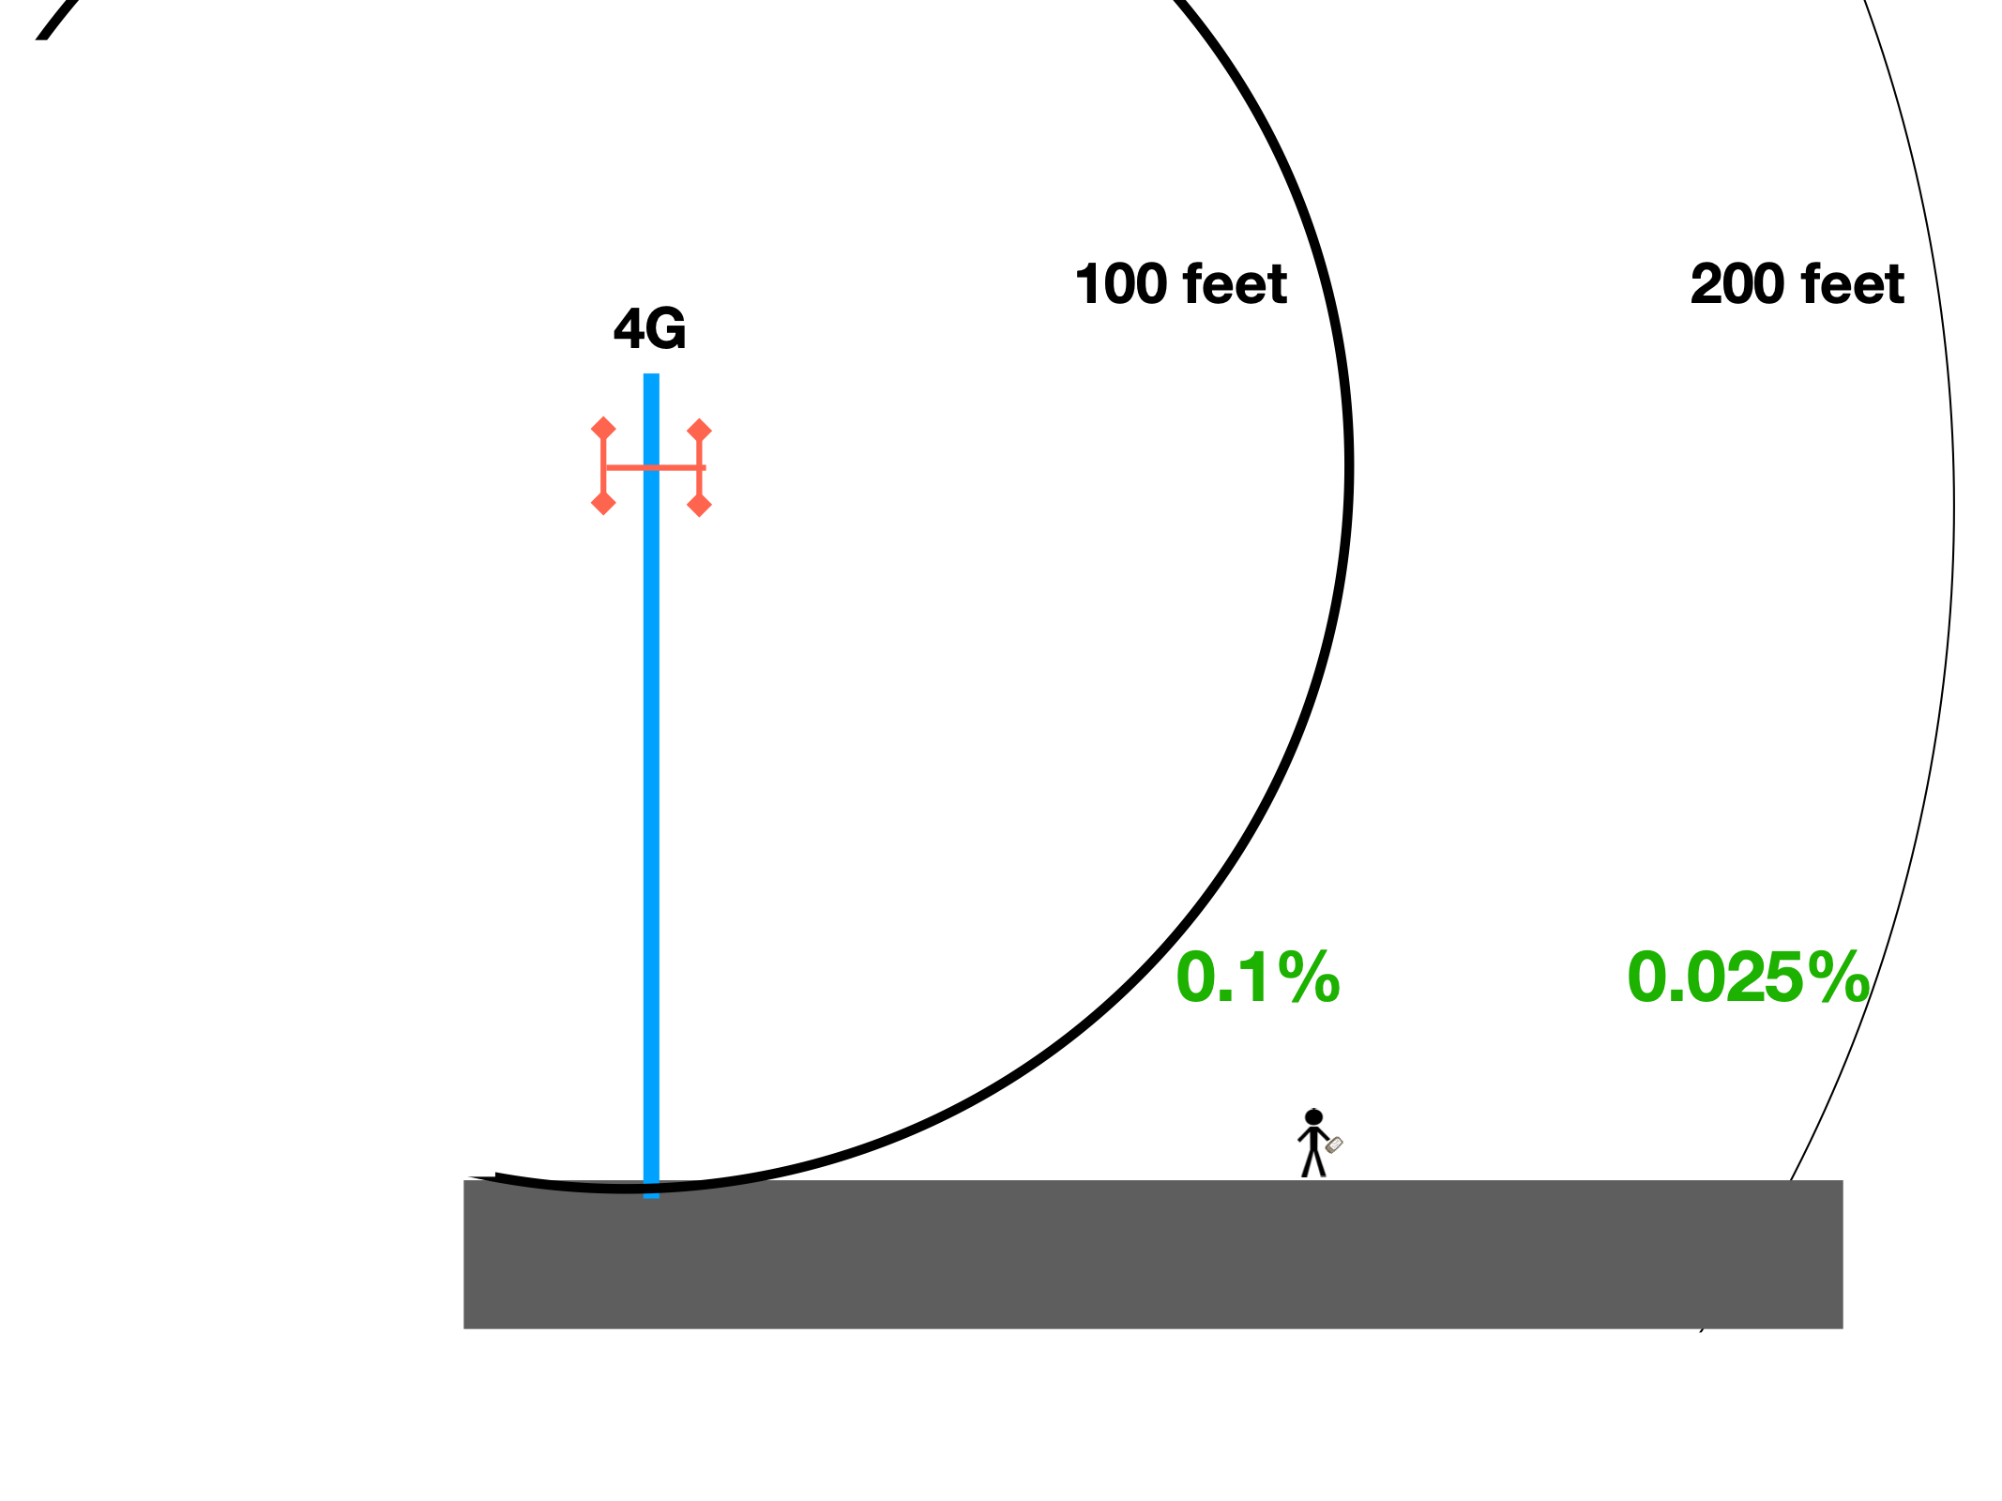
Typical Exposure due to a 4G tower
As a fraction of MPE

