Slide 1
Network Need in Woodbridge
Ziad Cheiban Verizon RF Design Engineer

Slide 2
Why Do We Need an Additional Cell Site?
Coverage Holes on CT-63 (Amity Rd) and CT-67 (Seymour Rd)
Spotty Coverage in the Northern Portion of Woodbridge
Area with High Number of Customer Complaints
Area with High Concentration of Network Extenders

Slide 3
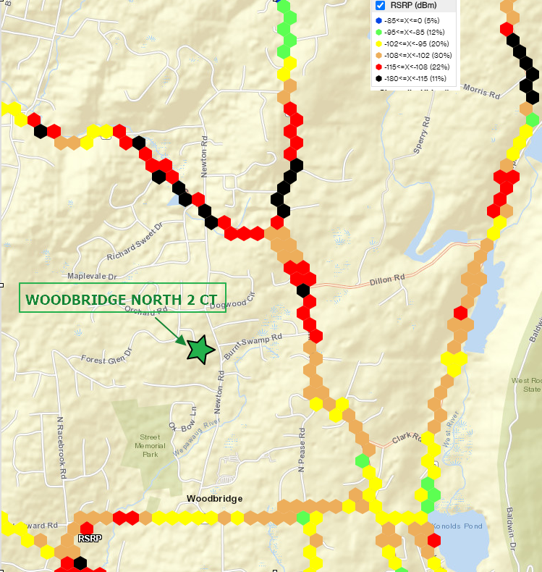
Coverage Holes: CT-63 & CT-67

Slide 4
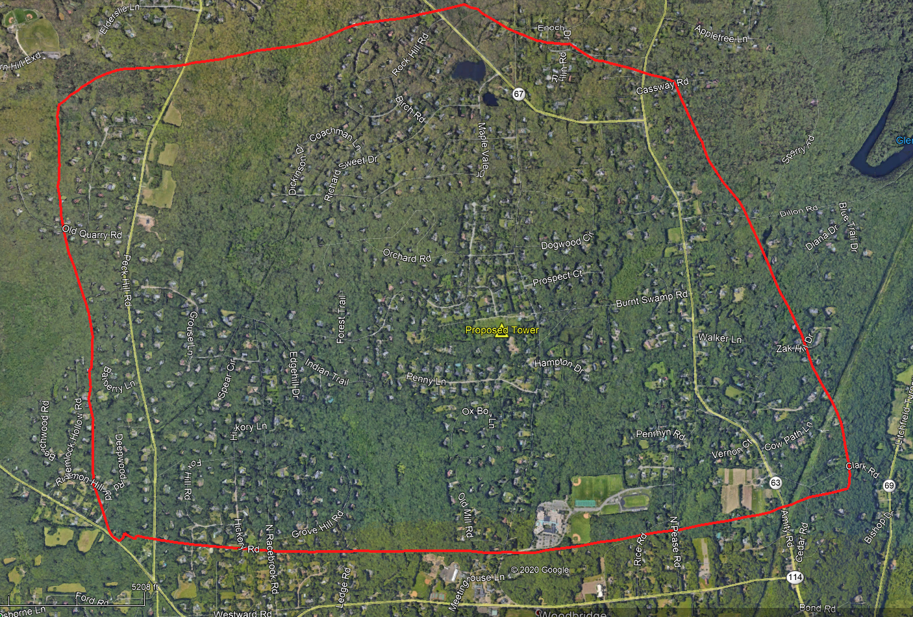
Spotty Coverage / Customer Complaints

Slide 5
Alternate Locations – Elevation Difference
Candidate | Ground Elevation | Elevation Difference
Proposed Location | 459 | -
Soundview Dr | 459 | 0
Burnt Swamp Rd | 365 | -94
RWA - Site A | 342 | -117
RWA - Site B | 351 | -108
RWA - Site C | 231 | -228
RWA - Site D | 396 | -63
RWA - Site E | 370 | -89
RWA - Site F | 377 | -82
Dillon Rd - Site 1 | 382 | -77
Dillon Rd - Site 2 | 378 | -81
Dillon Rd - Site 3 | 357 | -102
Meeting House Ln - Site A | 293 | -166
Meeting House Ln - Site B | 316 | -143
Meeting House Ln - Site C | 331 | -128
Meeting House Ln - Site D | 290 | -169

Slide 6
